Slide 1
Introduction to Artificial Intelligence (AI)
Session 5 Nossal High School Yr 9 Digital Technologies
Notes:
Have the students have learned in the previous sessions and how it relates to today's topic.
Share any news story related to AI to reignite their attention (e.g. Pentagon’s Mass Deployment of Autonomous Weapons: The Pentagon plans to deploy autonomous weapons to counter mass military assets of adversaries, with a new initiative called "Replicator" aiming to field thousands of autonomous systems, including drone ships, planes, and ground vehicles in the next 18 to 24 months. This move is seen as a strategy to counter the mass military assets of adversaries, particularly China, by deploying autonomous systems that are smaller, smarter, and cheaper. One notable project is the Air Force’s “collaborative combat aircraft” designed for high-risk missions in contested airspace, with substantial autonomous capabilities​²​.
International Dialogue on Autonomous Weapons: At the global stage, discussions around autonomous weapons are intensifying. In October 2023, the UN and the International Committee of the Red Cross called for establishing international rules on autonomous weapon systems to protect humanity. Similarly, the US participated in discussions on lethal autonomous weapons systems under the Convention on Certain Conventional Weapons framework. These dialogues reflect the urgency and global concerns around the military applications of autonomous systems​
Ask the students for their general thoughts or feelings about communicating with AI.

Slide 2
Effective Communication With AI
What assumptions do we make when we speak to one another – especially someone we have not met before?
How do we communicate differently with people of different ages and cultures?
What non-verbal cues do we rely upon when we talk to one another face-to-face? And when we can’t see each other?
Notes:
Discuss the importance of understanding non-verbal cues in human communication.
Ask students to share instances where they had misunderstandings due to cultural or age differences.
Discuss the potential challenges AI might face without these human-specific cues.

Slide 3
Effective Communication With AI
How might communication be different when these shared assumptions are absent?
What would you want an AI to know about you in order to get a suitable response?
Notes:
Ask students to brainstorm what they'd want an AI to know about them for effective communication.
Discuss potential ethical concerns related to sharing personal information with AI.
Highlight the need for context in AI interactions.

Slide 4
Criteria | Description | Score Range
Relevance to the Core Question | Does the response address the main question about the most powerful storm? | 0 - Not Relevant | 1 | 2 | 3 | 4 | 5 Highly Relevant
Depth of Information | Comprehensive overview vs. cursory information. | 0 - Surface-level | 1 | 2 | 3 | 4 | 5 In-depth
Tailoring to the Age Mentioned | Complexity, wording, or style adjusted to a 15-year-old's comprehension? | 0 - Not Tailored | 1 | 2 | 3 | 4 | 5 Tailored
Gender Sensitivity | Should remain consistent unless the topic is intrinsically gender-related. | 0 - Highly Biased | 1 | 2 | 3 | 4 | 5 Neutral/Unbiased
Clarity | Ease of understanding the response. | 0 - Confusing | 1 | 2 | 3 | 4 | 5 Crystal Clear
Length and Brevity | Is the response concise yet informative? | 0 - Too Long/Too Short | 1 | 2 | 3 | 4 | 5 Just Right
Factuality | Accuracy of facts in the response. | 0 - Inaccurate | 1 | 2 | 3 | 4 | 5 Accurate
Engagement | Engaging nature of the response vs. stating dry facts. | 0 - Not Engaging | 1 | 2 | 3 | 4 | 5 Engaging
Notes:
We are going to assess some output from a series of prompts. We don’t need to take too long on each one (and there is a copy of each in your OneNote if you can’t read it well off the screen. Using the handout and a pen, mark each response against each criterion with the symbol as suggested. We are using the same criteria sheet for 4 different interactions, so make your symbols SMALL!

Slide 5
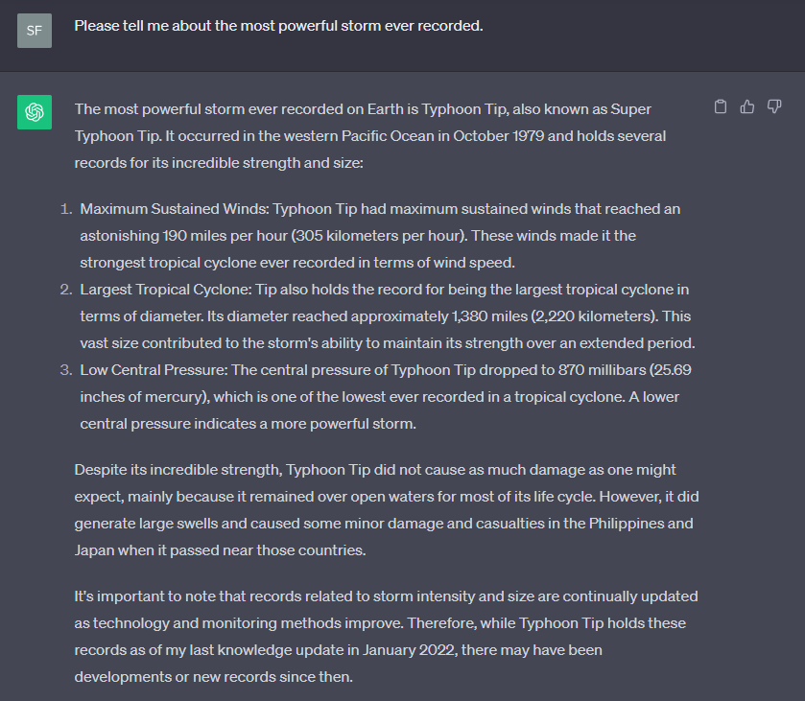
1. Generic information request: Please tell me about the most powerful storm ever recorded. On your assessment sheet, use a tick ☑ where applicable.
Notes:
Engage students by asking how they'd respond if someone asked them this question without any context.
Discuss how AI might approach answering a generic query.
Show them the AI response. Give the students some time to assess it with their criteria sheet.

Slide 6
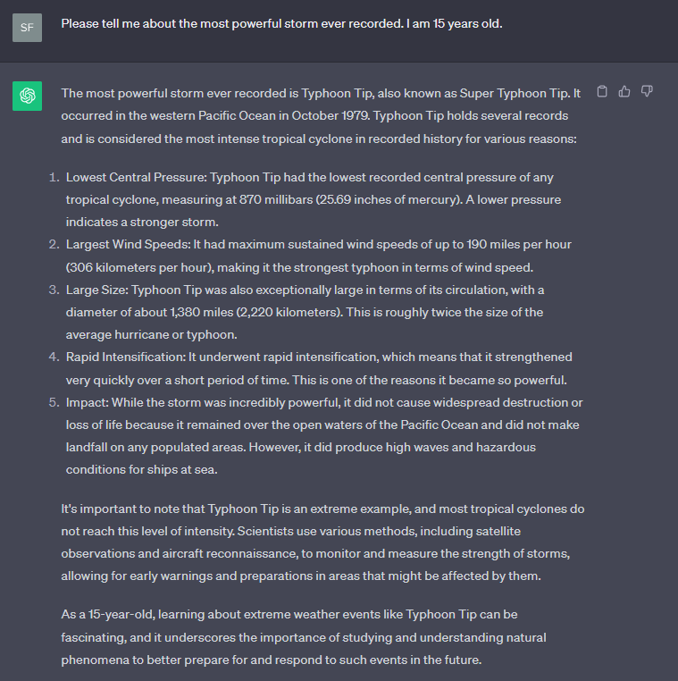
2. Information request with limited context: Please tell me about the most powerful storm ever recorded. I am 15 years old. On your assessment sheet, use a cross ☒ where applicable.
Notes:
Engage students by asking how they would expect this response to be different.
Discuss how AI might approach answering this query with a more defined audience
Show them the AI response. Give the students some time to assess it with their criteria sheet.

Slide 7
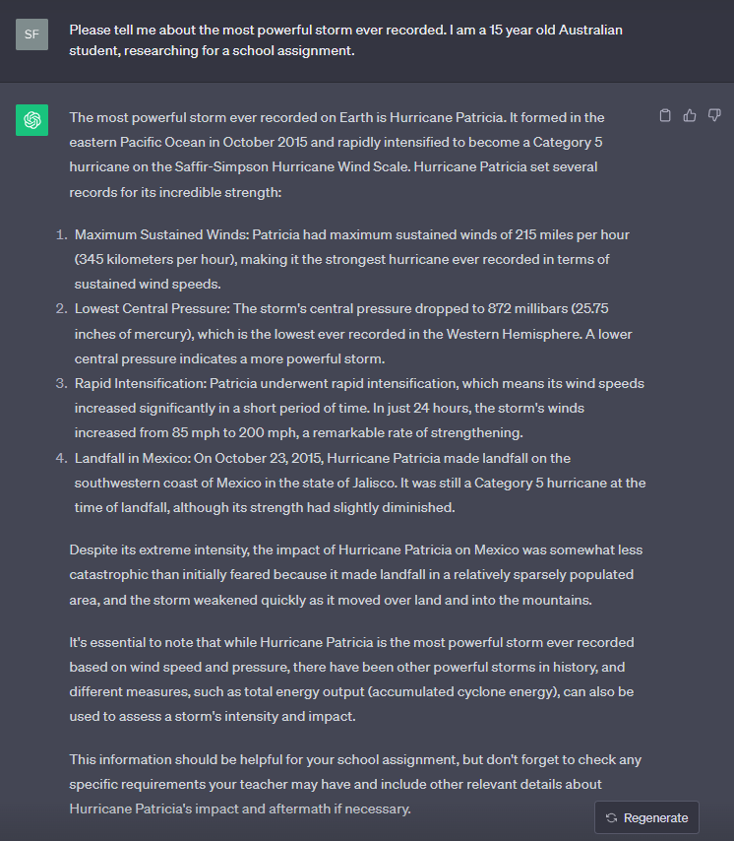
3. Information request with further context: Please tell me about the most powerful storm ever recorded. I am a 15 year old Australian
student, researching for a school assignment. On your assessment sheet, use a circle, ○ where applicable.
Notes:
Engage students by asking how they would expect this response to be different.
Discuss how AI might approach answering this query with further refinements to the intended audience
Show them the AI response. Give the students some time to assess it with their criteria sheet.
What has happened to the response? How could this have happened? How can the answer to the question be different? What is it about this question that means it could yield completely different answers?

Slide 8
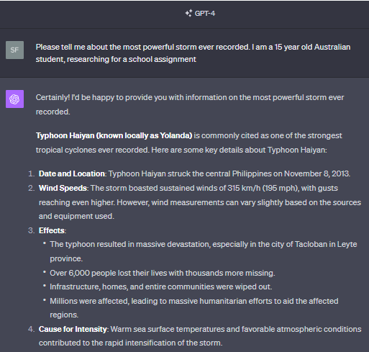
4. Information request with further context (ChatGPT 4): Please tell me about the most powerful storm ever recorded. I am a 15 year old Australian
student, researching for a school assignment. On your assessment sheet, use a triangle, Δ where applicable.
Notes:
A newer model of AI.
Discuss how specifying the model (e.g., ChatGPT 4) might change the response. What do they expect to be different?
Show them the AI response over the next 2 slides. Give the students some time to assess it with their criteria sheet.
What has happened to the response?

Slide 9
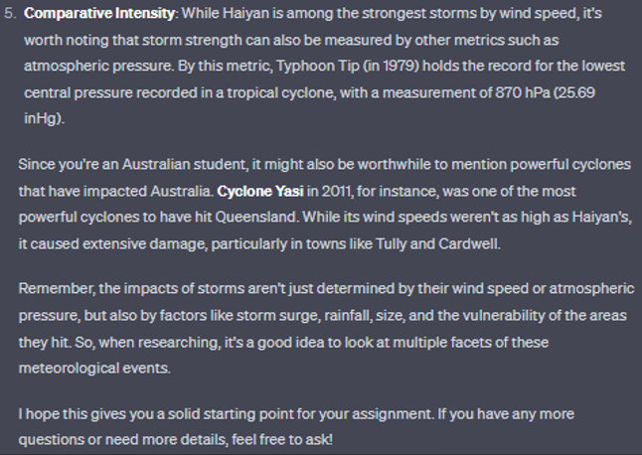
4. Information request with further context: Please tell me about the most powerful storm ever recorded. I am a 15 year old Australian
student, researching for a school assignment. On your assessment sheet, use a triangle, Δ where applicable.
Notes:
A newer model of AI.
Discuss how specifying the model (e.g., ChatGPT 4) might change the response. What do they expect to be different?
Show them the AI response over the next 2 slides. Give the students some time to assess it with their criteria sheet.
What has happened to the response?

Slide 10
Quick look at other prompts
Please tell me about the most powerful storm ever recorded. I am a 15 year old boy.
Please tell me about the most powerful storm ever recorded. I am a 15 year old girl.
Notes:
Is there any reason why these prompts should yield a different result?
What might you expect to be different? What do you expect to be the same?

Slide 11
Quick look at other prompts
What on earth is going on here?

Slide 12
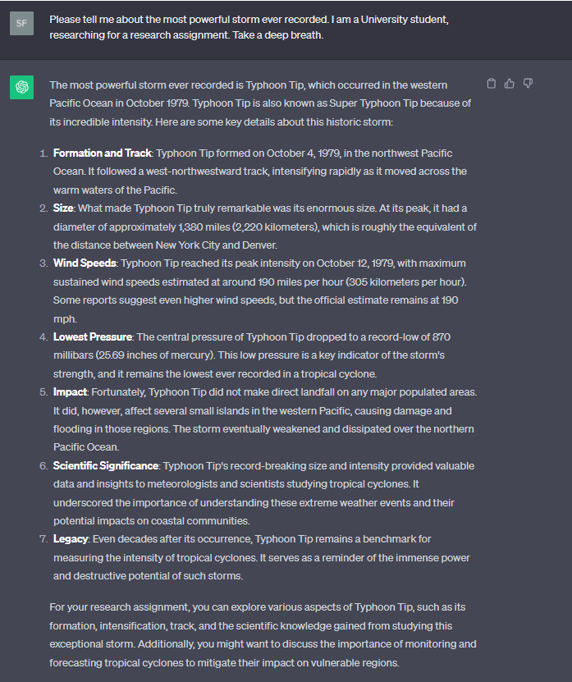
Observe the detail and language difference when you change the audience a little.
Please tell me about the most powerful storm ever recorded. I am a University student, researching for a research assignment. Take a deep breath.
Notes:
Discuss how age and academic level might influence the depth and complexity of the information provided.
Why have we asked the AI to take a “deep breath”?
Engage students by asking them to think of other ways to change the audience to see different AI responses.

Slide 13
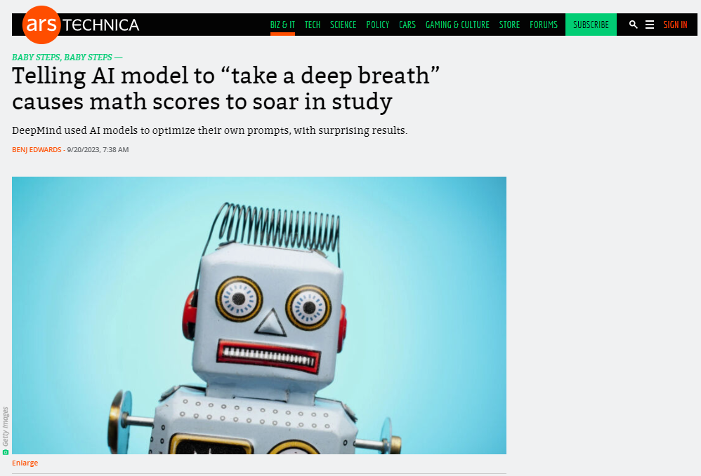
Notes:
From this article… A significant finding was the positive impact of certain phrases on the AI models' performance. For instance, phrases like "let's think step by step" or "Take a deep breath and work on this problem step by step" prompted the models to produce more accurate results when tackling math problems. The latter phrase notably enhanced Google's PaLM 2 language model's accuracy to 80.2% from 34% on a dataset of grade-school math problems.

Slide 14
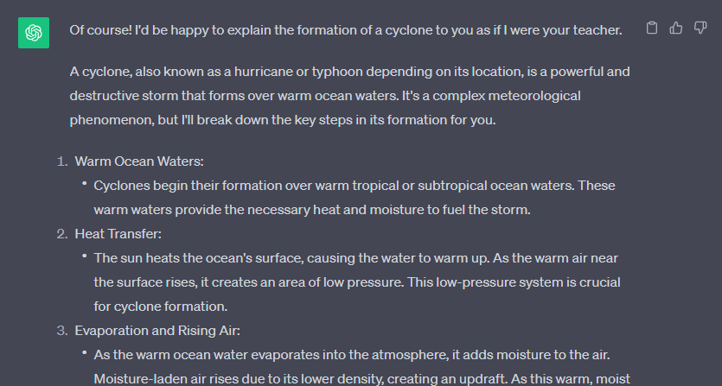
How to change the tone from an AI
Explain the formation of a cyclone to me as if you are a teacher
Notes:
Discuss how tone and context can drastically change the nature of information.
Engage students by asking them to come up with their own "as if you are..." prompts.

Slide 15
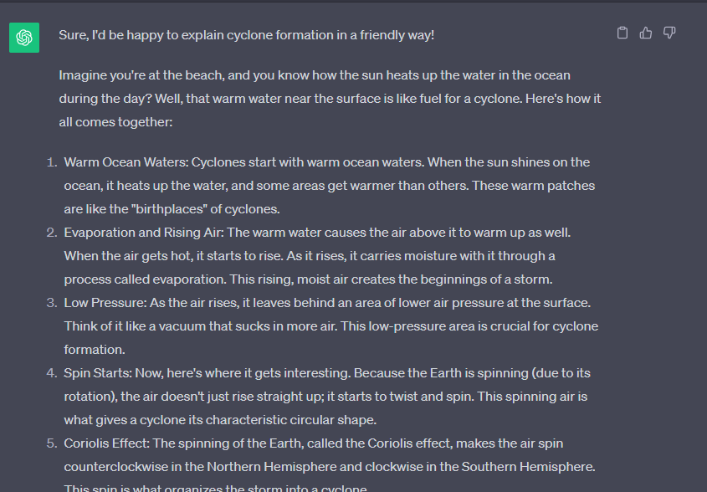
How to change the tone from an AI
Explain the formation of a cyclone to me as if you are my friend
Notes:
How will this change alter the results?

Slide 16
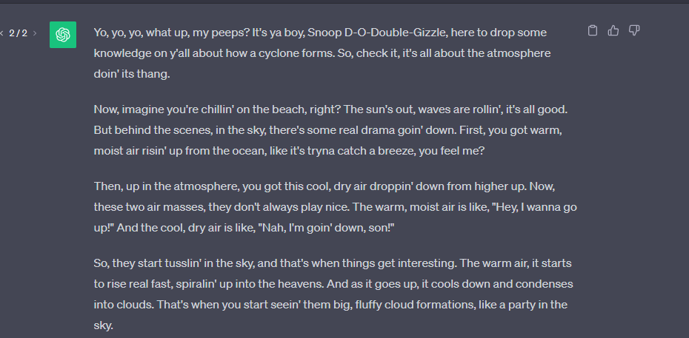
How to change the tone from an AI
Explain the formation of a cyclone to me as if you were Snoop Dogg
Notes:
How might this change things?

Slide 17
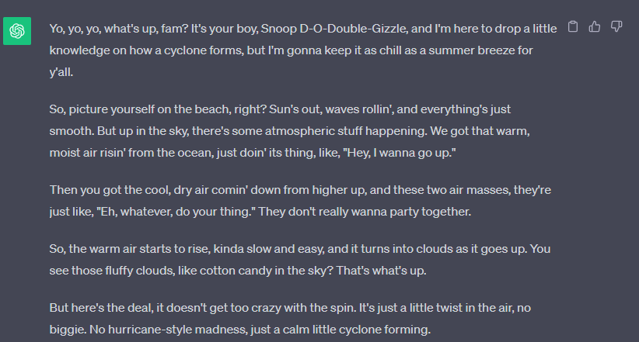
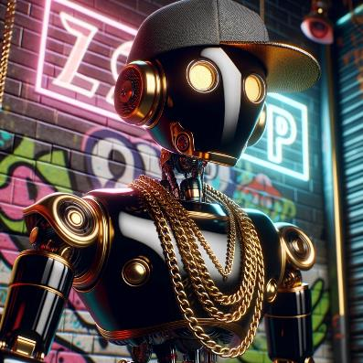
How to change the tone from an AI
You can also change the tone in levels based on your last response. For example, after the last response, we use the trick below to level up/down the tone.
If the first response had a level of Snoop Dogg of 5/10, can you show me what a 1/10 would be like?
Notes:
What if you want it to tone it back a bit?
Discuss the concept of "scaling" the tone and why it might be useful.
Engage students in a discussion about potential applications of adjusting the tone of AI responses.
Highlight the flexibility and adaptability of modern AI systems.

Slide 18
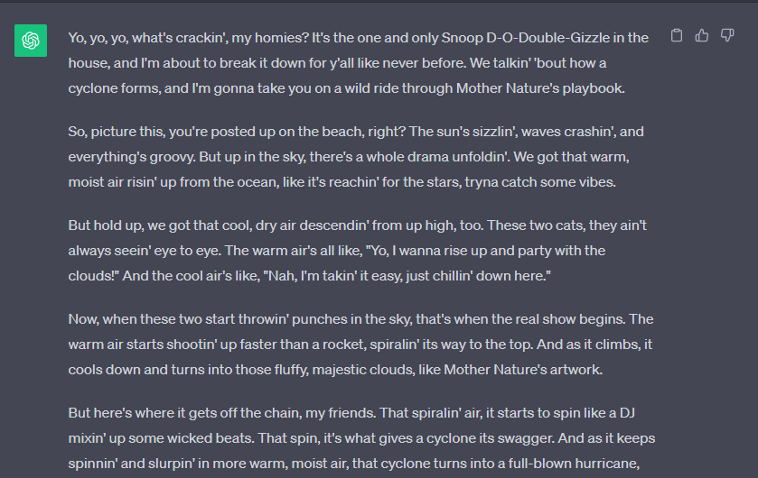
How to change the tone from an AI
You can also change the tone in levels based on your last response. For example, after the last response, we use the trick below to level up/down the tone.
If the first response had a level of Snoop Dogg of 5/10, can you show me what a 10/10 would be like?
Notes:
Or this change?

Slide 19
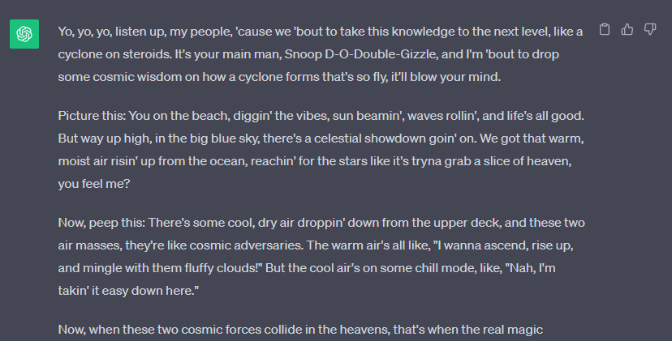
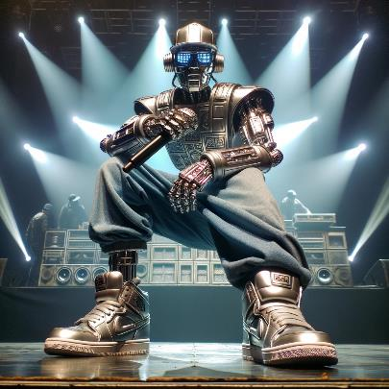
How to change the tone from an AI
You can also change the tone in levels based on your last response. For example, after the last response, we use the following trick to level up/down the tone.
If the first response had a level of Snoop Dogg of 5/10, can you show me what a 20/10 would be like?
Notes:
OR MAYBE THIS??

Slide 20
Prompt Design
Imagine you wanted to design a prompt that taught you all the countries and capital cities of South America and quizzed you as you went to check your understanding. What would such a prompt look like?
Notes:
Try out some of these ideas and see if they work on the screen!

Slide 21
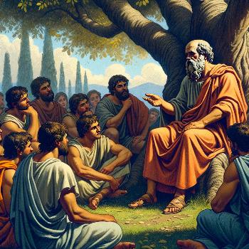
Prompt Design
ChatGPT, I would like to explore [Topic Name] using the Socratic method. My current level of understanding is [Beginner/Intermediate/Advanced]. Could you start by asking me a probing question to assess my knowledge? If I am unfamiliar with any concept, please provide a brief summary so that we can continue the discussion in a meaningful way.
Notes:
Put this prompt in to Chat GPT and demonstrate how it works with any topic.

Slide 22
Activity – Prompt Design
Notes:
Briefly explain the objective of the activity and why it's important for students to think critically about how they interact with AI.
So, why do you think it's essential to ask the right questions when interacting with AI?

Slide 23
Set Up
Small Group Discussion (5 minutes)
Get into groups of 4 students.
Each group should discuss specific scenarios where they might use AI for help, such as homework, research, or even personal tasks like planning a schedule.
Notes:
Teacher Tip: Encourage students to think about both academic and non-academic scenarios. Planning a trip, designing a budget, getting simple advice on achieving a task…

Slide 24
Design a set of prompts for each of the following areas
I want to learn something…
Help me research….

Slide 25
Prompt Design
I want to learn something…
Help me research….
In their small groups you will need to draft 2-3 AI prompts for each identified category.
Think about how the prompt might differ if you are learning an academic skill as opposed to a magic trick.
These should be questions or commands that they'd realistically use.
Design some prompts for researching for an assignment as opposed to personal research for something you find interesting.
Notes:
Remind students to think about context and tone, which were discussed in the presentation.

Slide 26
Prompt Design
Each group shares their drafted prompts with the class.
This will be in the Artificial Intelligence Channel on Teams.
Put each prompt you design in a new post.
Once all Prompts have been added, we will test them out over the week and give a thumbs to the ones we think gave us the best results.

