Slide 1
AI and Ethical Challenges
Session 3 Nossal High School Yr 9 Digital Technologies

Slide 2
London Symphony plays a score written by an AI

Slide 3
Bad Science and AI

Slide 4
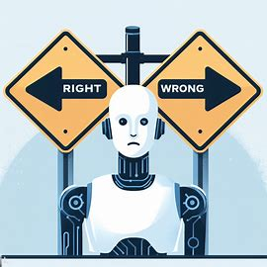
Group Task
We are going to explore an Ethical Dilemma brought about by the use of an AI used in place of huma judgement. All of the scenarios are REAL and are happening somewhere in the world right now

Slide 5
AI & Ethics
AI in Autonomous Weapons
AI in Criminal Sentencing
AI and Deepfake Journalism
The Social Media Filter Bubble
Algorithmic Hiring Bias
AI Surveillance at School
AI in Self-Driving Cars
AI and Creative Works
AI in Healthcare Decision-Making
AI and Political Manipulation
AI in Healthcare Resource Allocation
AI in Youth Mental Health Support
AI in Biometric Surveillance

Slide 6
Group Task (continued)
You will have around 30 minutes as a group to work through your responses to prompts provided for your topic area.
Once you have responses to the prompt, you will then need to summarize your work for the class. You will be presenting a 2 ½ to 3 minute presentation next week. Divide this element up so you are all speaking for equal lengths of time.

Slide 7
Assessment
As a group you will be assessed with H/M/L/NS for the following criteria:
Understanding the Ethical Dilemma (depth of understanding and engagement with the prompts provided) – shared mark
Collaboration (work was spread equally) - shared mark
Critical Thinking (evidence that personal contribution involved reflection and use of high-level thinking) – individual mark
Communication Skills (information presented was coherent and relevant) – individual mark

