Slide 1
How AI works and ethical challenges
Session 2 Nossal High School Yr 9 Digital Technologies
Notes:
Briefly introduce what Artificial Intelligence is and why it's relevant in today's world.
Explain the goal of the session and what students can expect to learn.
Share the fact that the term "Artificial Intelligence" was first coined in 1956 at the Dartmouth Conference.
Ask, "Did you know that AI can compose music? AI-composed tunes have even been performed by the London Symphony Orchestra."

Slide 2
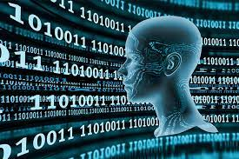
Supervised Vs Unsupervised Learning
Supervised Learning:
Definition: Supervised learning is a type of machine learning where the model is trained on labeled data. The "supervision" consists of the model making predictions and then being corrected by the label whenever it's wrong.
Data: Requires a dataset where the "answer" or "label" is known for each input. For instance, in a dataset for email classification, each email will be labeled as "spam" or "not spam".
Goal: The primary goal is to learn a mapping from inputs to outputs and make predictions on new, unseen data based on this mapping.
Applications: Image recognition (labeling images as containing a cat, dog, etc.), Predictive modeling (predicting stock prices, weather, etc.), Classification tasks (determining if an email is spam or not)
Unsupervised Learning:
Definition: Unsupervised learning involves training a model on data where no explicit labels are provided. The model tries to learn the underlying structure or distribution of the data.
Data: Uses datasets without any explicit labels. The model tries to identify patterns or similarities within the data on its own.
Goal: The primary goals are often clustering (grouping similar data points together) or dimensionality reduction (simplifying data without losing key information).
Applications: Analyzing your social media feed - grouping posts based on content. Real-world applications would include content recommendation and categorization on platforms like Instagram or Twitter. Movie or Book Genre Identification - given a collection of movies or books without genre labels, unsupervised learning might group them into categories like action, romance, mystery, or sci-fi based on content, themes, and styles. Real-world applications would include content organization on platforms like Netflix or Goodreads.
Notes:
Contrast supervised and unsupervised learning with real-world examples.
Discuss how data is labeled in supervised learning.
Explain the goals of each type of learning: supervised aims for predictions, unsupervised aims for understanding structure.
Discuss applications, perhaps asking students to think of examples they encounter in daily life.
Mention the IBM Watson's victory on "Jeopardy!" as a milestone in supervised learning.
Share a fun fact: Unsupervised learning techniques are used to categorize different galaxies in astronomy.

Slide 3
AlphaZero
AlphaZero, developed by DeepMind, represented a significant leap in the realm of artificial intelligence and game-playing. Unlike traditional chess engines, which rely on predefined openings and vast databases of previously played games, AlphaZero used a different approach. It employed a combination of deep neural networks to evaluate board positions and determine moves.
The learning process of AlphaZero is particularly fascinating because it was entirely self-taught. Starting with only the basic rules of chess, AlphaZero played games against itself, improving with each iteration. Within hours, it had played more games than a human could in multiple lifetimes. By analyzing the outcomes of its self-played games and adjusting its neural network parameters accordingly, AlphaZero quickly ascended to superhuman levels of play. This self-play and iterative refinement allowed it to discover strategies, tactics, and even revive certain openings that were considered non-standard by human grandmasters. The result was a chess-playing entity that not only outperformed other top chess engines but also showcased a style of play that was both aggressive and nuanced, often leading to games that were described as both innovative and beautiful by chess enthusiasts. After four hours of training, DeepMind estimated AlphaZero was playing chess at a higher rating than all other chess playing engines. After nine hours of training, the algorithm defeated the best chess engine in the world in a time-controlled 100-game tournament with 28 wins, 0 losses, and 72 draws.
Notes:
Talk about the capabilities of AlphaZero in game playing.
Discuss natural language processing and its applications like chatbots and translation.
Address the ethical considerations associated with AI, such as data privacy and job displacement.
Discuss how AlphaZero taught itself chess in just 4 hours and then beat the world's best chess engine.
Mention how natural language processing (NLP) is behind real-time translation services like Google Translate.

Slide 4
Teachable Machine (by Google)
https://teachablemachine.withgoogle.com
Tutorials on Teachable Machine
Notes:
- Engage students with a question: "Do you think machines can ever have emotions?"
- Discuss how AI is even entering the art world, with algorithms creating artworks that have been auctioned for thousands of dollars.
- Watch all the Tutorials first and then demo the site before getting students to complete the tasks on the next page of the powerpoint

Slide 5
Use Teachable machine to do the following:
Visual Identity Tasks
Audio Identity Tasks
Identify you from the other members of your table group.
Use the Pose option to identify happy from sad facial expressions.
Use the Pose option to identify a bored stance from an excited stance.
Identify your voice from the other members of your group.
Is it smart enough to identify your clap from your friend’s clap?
Is it smart enough to identify your whistle from your friend’s whistle?
Notes:
Complete the task as described

Slide 6
Reflection
How well did it train on your facial expressions?
Could it reliably tell you apart from your friends?
How could this program be used for good?
What could be dangerous about the use of this software?
Notes:
Complete the task as described above

Slide 7
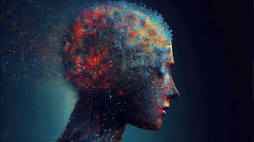
Neural Networks
Understanding a Neural Network
The Neural Network Playground
Use the Neural Network Playground to look at how many neurons it takes to approximate different data sets using a ReLU Activation.
Which patterns take the most neurons to match effectively?
Which patters are easiest for a neural network to map? How may does it take for each one?
Notes:
Watch the tutorial videos and then demonstrate the playground.
Have the students then use the playground to answer the questions (5-7 min)

Slide 8
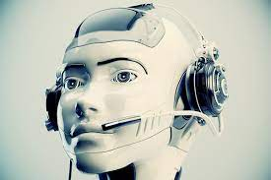
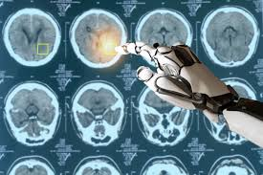
Machine Learning & Deep Learning in Our World
Everyday Applications
Personal Assistants: Siri, Alexa, Google Assistant Content Recommendations: Netflix, YouTube, Spotify Social Media: Personalized feeds on Facebook, Instagram, Twitter
Industry-Specific Applications
Healthcare: Diagnostic AI, personalized medicine Finance: Fraud detection, algorithmic trading Transportation: Self-driving cars, traffic prediction Education: Adaptive learning platforms, automated grading (including Naplan! ☺)
Notes:
Share that Siri uses machine learning to understand accents, citing that it can now understand over 20 languages.
Mention the Netflix Prize, a competition to improve Netflix's recommendation algorithm, which had a $1 million reward.
Ask, "Did you know that Facebook's algorithm can predict if a relationship will last based on interaction metrics?"

Slide 9
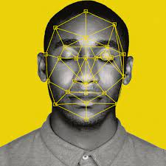
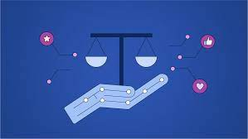
Machine Learning & Deep Learning in Our World
Technological Milestones:
Image Recognition: Google Photos, facial recognition Natural Language Processing: Chatbots, translation services Game Playing: AlphaGo, AlphaZero
Ethical Considerations
Data Privacy: How is our data being used? Bias: Can algorithms be biased? Job Displacement: Automation and the workforce
Notes:
State that Google Photos can distinguish between individual pets, not just humans, thanks to advanced image recognition.
Share the fact that the Turing Test, designed to measure a machine's ability to exhibit human-like intelligence, has been "passed" under certain conditions by chatbots like Eugene Goostman.
Discuss the 2016 Go match where Google's AlphaGo defeated world champion Lee Sedol, marking a milestone in AI capabilities.

Slide 10
Machine Learning & Deep Learning in Our World
Future Prospects
Climate Change: Predictive models for weather and climate Medicine: Drug discovery, genomics Smart Cities: Internet of Things (IoT) applications for energy management, public safety
Notes:
Pose the question, "Did you know that AI algorithms are being used to predict the spread of forest fires?"
Cite the 2020 discovery where MIT researchers used AI to identify a new antibiotic compound, halicin, effective against antibiotic-resistant bacteria.
Discuss the Smart Dubai initiative, aiming to make Dubai the world's smartest and happiest city through IoT and AI applications like smart grids and traffic management.

Slide 11
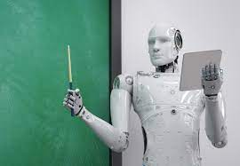
Activity
Scenario:
Let’s imagine that all teachers stopped being responsible for the correction of your work (essays, tests, homework) and the job was handed over to an AI engine. This engine needs to be trained in order to complete the work. We are going to evaluate the implications of this project...
Objective:
To critically evaluate the ethical implications of using an AI engine for grading student work in educational settings.
Notes:
Explain the hypothetical scenario where AI takes over the role of grading in education.
Discuss the objective of evaluating ethical implications and why it’s important.

Slide 12
Activity (continued)
Discussion:
What do we think about such a scenario? Gut feelings? Good/Bad/Don’t Care?
Who are the stakeholders involved? What might they think from their different perspectives?
Notes:
Encourage students to share their initial reactions to the scenario.
Discuss the stakeholders involved, such as students, teachers, and educational institutions.
Probe what these stakeholders might think from their perspectives.

Slide 13
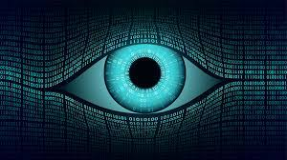
Activity (continued)
Ethical Factors to Consider
Fairness: Is the AI engine equally accurate for all students, regardless of writing style, language proficiency, etc.? Accountability: Who is responsible if the AI engine makes a mistake or is biased? Transparency: Do stakeholders know how the AI engine works and how decisions are made? Data Privacy: How is student data handled, stored, and protected? Societal Impact: What are the broader implications for the teaching profession and the educational system? Accessibility: Is the technology accessible to all students/teachers, including those with disabilities, low incomes, regional areas, etc.?
From a student perspective, discuss in your table groups the ethical factors listed.
Notes:
Delve into each ethical factor listed, asking students to consider them from a student’s perspective.
Discuss who would be accountable for mistakes and how transparency is maintained.

Slide 14
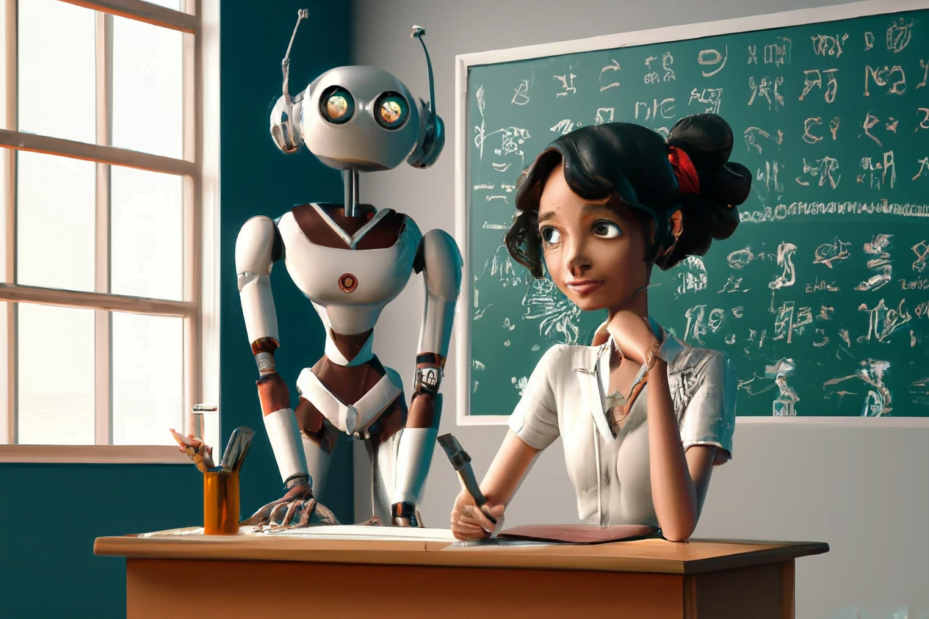
Activity (continued)
On formative.com, complete your personal response to the ethical considerations of using AI in your education.
Notes:
Direct students to complete their personal responses online.
Mention that this will help them think critically about the ethical considerations discussed.

