Slide 1
Introduction to Artificial Intelligence (AI)
Session 1 Nossal High School Yr 9 Digital Technologies
Notes:
- Today, we're diving into a topic that's shaping our world—Artificial Intelligence. This isn't sci-fi; it's real and it's happening now.
How many of you have interacted with AI without realizing it? Spoiler alert: almost all of you have.
As we explore AI today, think about how it's already affecting your life and how it might in the future.

Slide 2
What is AI?
Artificial Intelligence (AI) refers to the simulation of human intelligence in machines, enabling them to perform tasks that typically require human-like thinking, such as problem-solving, pattern recognition, decision-making, and learning.
It encompasses a range of technologies and methods, including machine learning, neural networks, and natural language processing, to achieve its goals
Notes:
- AI isn't just robots and talking computers. It's also the algorithm that suggests your next song on Spotify.
When you use Google Maps to find the quickest route, that's AI at work. It's more ingrained in our lives than we realize.
Quick poll: How many of you think AI is a good thing? And how many are skeptical? Keep these thoughts as we move along.

Slide 3
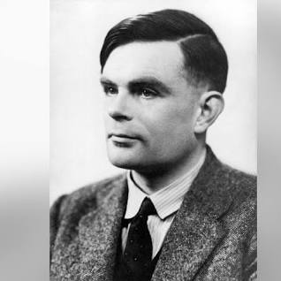
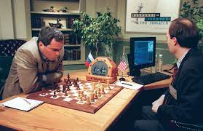
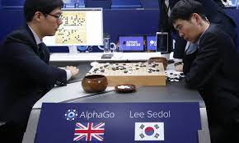
A Brief History of AI
1950s: Turing Test. Alan Turing proposes a measure of machine's ability to exhibit intelligent behavior indistinguishable from a human. 1990s: Deep Blue. IBM's chess-playing computer defeats world champion Garry Kasparov.
2010s: Deep Learning. Neural networks with many layers revolutionize tasks like image and speech recognition. AlphaGo. DeepMind's program defeats world champion in the game of Go. Learns chess in 1 day by playing itself, defeats all other Chess AIs.
2020s: GPT-3 & Beyond: Large language models demonstrate human-like text generation capabilities.
Notes:
- The concept of AI isn't new. Even ancient myths have stories of animated statues and mechanical beings.
- Ever heard of Alan Turing? He laid the foundations for both computer science and artificial intelligence.
- The 1950s marked the beginning of AI as an academic field. Fast forward to today, and it's a multi-billion-dollar industry.

Slide 4
AI Vs ML Vs DL
AI Learns to Walk (deep reinforcement learning)
AI Vs DL Vs ML
Notes:
- AI, Machine Learning, and Deep Learning—What's the difference? They're interconnected but not interchangeable.
- Think of it as a set of nesting dolls: AI is the largest, ML fits inside it, and DL fits inside ML.
- Why does this matter? Because solving different problems requires different levels of computational 'intelligence.’ - Show *some* of the AI Learns to walk video, occasionally skipping along as required (around 2 min) - Watch the AI Vs DL Vs ML video (3 min and 30 sec)

Slide 5
AI Across Different Fields
Healthcare: Medical image analysis, Drug discovery assistance, Personalized treatments
Finance: Algorithmic trading, Fraud detection, Robo-advisors
Entertainment: Content recommendations, Adaptive game characters, AI-generated art/music
Retail: Inventory predictions, Personalized shopping, Customer service chatbots
Transportation: Self-driving cars, Traffic optimization, Predictive maintenance
Agriculture: Crop health monitoring, Automated irrigation, Pesticide/fertilizer optimization
Manufacturing: Predictive machine maintenance, Supply chain optimization, Product design assistance
Education: Personalized learning, Administrative automation, Virtual learning tools
Energy: Demand forecasting, Smart grid optimization, Equipment monitoring
Environment: Natural disaster prediction, Endangered species tracking, Climate data analysis
Notes:
- AI isn't limited to just tech or science. It's penetrating arts, humanities, and even sports.
- From predicting earthquakes to diagnosing diseases, AI is revolutionizing various fields.
- Quick exercise: In groups, brainstorm a field where AI could be beneficial but hasn't been extensively used yet.

Slide 6
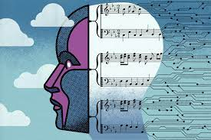
AI in Entertainment
Music & Film:
Recommendations: AI analyses user preferences to suggest songs and movies.
Video Games:
Adaptive Gameplay: AI adjusts game difficulty based on player skill.
Realistic NPCs: Non-player characters (NPCs) behave more lifelike.
Content Creation:
AI Art: Algorithms generate visual art pieces.
Music Composition: AI creates melodies or assists composers.
Notes:
- AI can write movie scripts, compose music, and even create art. Imagine a future Oscar-winning movie written by a machine!
- In gaming, AI isn't just for creating smarter opponents. It can adapt game scenarios in real-time based on your actions.
- What's the ethical line here? If an AI composes a song, who owns the copyright? Thoughts?

Slide 7
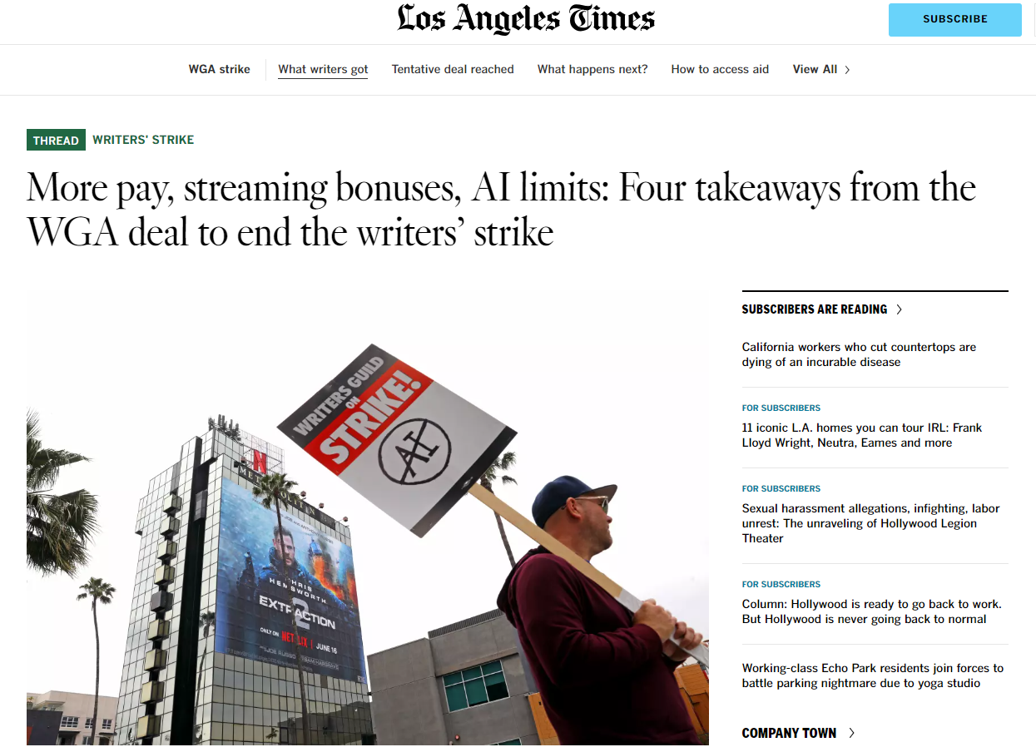

Slide 8
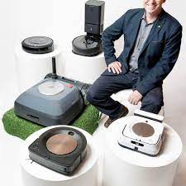
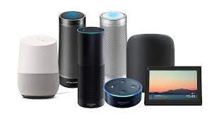
AI in Daily Tasks
Smart Assistants:
Hey Google, Alexa, Siri
Home Automation:
Tech that knows when you are there and what to do
Home Robotics
Google/Apple Maps:
AI that predicts traffic and routes
Notes:
- How many daily tasks do you think involve AI? Your morning alarm, your social media feed, and even your online shopping.
- Your phone's predictive text? That's AI. Your email spam filter? Also AI.
- Think about how AI saves you time each day. Now, consider the trade-offs. Are there privacy concerns?

Slide 9
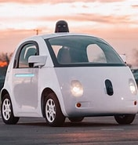
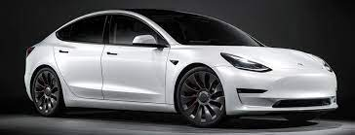
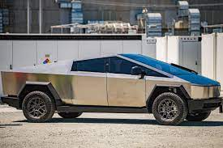
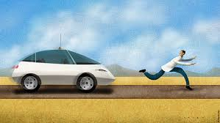
AI in Transportation
Self-Driving Cars:
Tesla, Waymo
Traffic Prediction:
Fastest Vs most fuel-efficient drive, rerouting while driving
Ethics and Decision making
Who decides what to do when a crash is unavoidable?
Notes:
- Self-driving cars are amazing, but what about autonomous public transport? Imagine a city with AI-controlled buses.
- AI can also manage traffic lights to reduce congestion. Smart cities are closer than you think.
- While it sounds fantastic, are there risks? What if an AI-controlled vehicle makes a mistake?

Slide 10
AI Perception Vs Reality
Robots: Machines capable of carrying out a series of actions automatically.
AI: Systems that can perform tasks that typically require human intelligence.
Common Misconceptions:
☒ Every Robot Thinks: Just because a robot can move or perform tasks doesn't mean it's "thinking" or learning from its environment.
☒ AI Equals Humanoid Robots: While some humanoid robots use AI, not all AI systems are robots. Many AI systems are software-based.
☒ All Automated Systems Have AI: Automation can be based on simple, pre-programmed instructions without any learning or adaptation.
Notes:
- Movies often depict AI as evil robots or saviors of humanity. But the reality is far more nuanced.
- Common misconceptions include the idea that AI can 'think' like humans. It can't—yet.
- Is AI a tool to enhance human capabilities, or is it a potential threat? There's a fine line.

Slide 11
AI Mind Map
Construct a mind map using Artificial Intelligence as your Central Theme
Notes:
- Let's get creative. How many areas can you think of where AI has a role?
- From healthcare to home automation, the possibilities are endless.
- Each table group will now create a mind map.

Slide 12
Why Learn About AI?
Pervasiveness of AI:
AI is everywhere: From our smartphones to our workplaces, from healthcare to entertainment.
Growing Influence:
Decision-making: AI systems influence choices in finance, shopping, and even news consumption.
Exployment: AI is reshaping industries, creating new roles while making others obsolete.
Informed Users:
Critical Users: Understanding AI helps users critically evaluate recommendations, decisions, and content generated by AI.
Ethical Awareness: Being informed promotes ethical use and awareness of potential biases in AI systems.
Notes:
- Understanding AI is akin to learning a new language. It's the language of future problem-solving.
- Even if you don't go into a tech career, AI will be a part of whatever field you choose.
- So, why should YOU learn about AI? Think about it. Your future job might not exist yet, but learning AI will prepare you.

Slide 13
What do we think?
In your table group, divide your A4 paper in two and brainstorm Concerns and Positives you see for using AI in our world. (5 min)
concerns
positives
Notes:
- Now that we've explored various aspects, what's your stance on AI? More optimistic or more cautious?
- 'AI will do more good than harm'—Who agrees and who disagrees?
- Remember, there's no right or wrong answer here. Your perspective is part of a larger conversation.

Slide 14
What do we think?
On your table, decide on your TOP 3 Concerns and TOP 3 Positives. (2 min). We write them on a whiteboard at the front of the room.
concerns
positives

Slide 15
What does ChatGPT4 think?
Concerns
Positives
Ethical and Bias Issues:
AI systems can inadvertently perpetuate or amplify societal biases present in their training data, leading to unfair or discriminatory outcomes.
Job Displacement:
As AI automates tasks, there's a concern about job losses in certain sectors, potentially leading to economic disparities and unemployment.
Privacy and Surveillance:
The extensive data collection required to train and operate many AI systems can infringe on individual privacy. Additionally, AI-powered surveillance tools can be misused by authoritative entities.
Efficiency and Productivity:
AI can handle repetitive tasks, analyze vast datasets quickly, and optimize processes, leading to increased productivity in various sectors.
Personalization and Convenience:
From personalized content recommendations to smart home automation, AI enhances user experiences by tailoring services to individual needs.
Solving Complex Problems:
AI has the potential to address grand challenges, from medical research (like drug discovery) to environmental issues (like climate modeling), by analyzing data at scales and complexities beyond human capability.
Notes:
Compare the student responses to the responses from ChatGPT 4. What are the students focused on Vs what ChatGPT is focused on?
A big question to ponder: Can AI like me ever replace human teachers? Why or why not?

Slide 16
Task: AI in My World
Objective: To identify and explore the influence and presence of AI in the students' personal lives and their local community.
Instructions:
Identification: Over the next week, take note of any instance where you believe AI might be at play in your daily life. This could be anything from a music recommendation on a streaming service to a self-checkout machine at a local store.
Research: Choose one of these instances and research further.
How does the AI work in this context?
What data might it be using?
Who created it, and for what purpose? Complete Q 1 & 2 on Formative
Reflection: Post to our AI Channel on Teams with responses to the following prompts.
Describes the AI instance you chose.
Explain its functionality and purpose.
Reflect on its benefits and potential drawbacks or concerns.
Notes:
- Let's get hands-on. Identify three ways AI affects your daily life.
- Next, think of a problem in your community. How could AI solve it?

