Slide 1
Responding to AI at Nossal HS
Tracey Mackin & Stuart Fankhauser

Slide 2
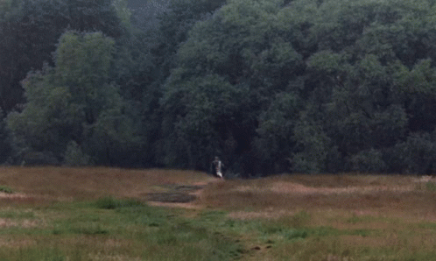
AI Arrives
Generative AI arrived, freely accessible and fully democratized in November of 2022
According to experts, “decades’ worth of progress happened this year" and "a year's worth of progress is now happening in months"
Teams of students/workers/researchers from now on will be comprised of human and non-human participants

Slide 3
AI @ Nossal
Initial Goals and Background Work
Whole School Approach
- Wellbeing
- Learning
AI as Tool For Admin and Teachers
2023
Responding to AI at Nossal High School

Slide 4
2023 AI GOALs
Raise awareness, build knowledge and provide opportunities for staff to discuss and explore AI
Develop a whole school response to AI
2023
Responding to AI at Nossal High School

Slide 5
Staff PL response
Demonstrating what is currently possible, discussing what is likely to be possible
Introduce AI to assist teachers with work
Make time for immediate responses
Authentic & valid assessment
Enlist staff to pilot a whole school model for AI in the classroom

Slide 6
Wellbeing
2023
Responding to AI at Nossal High School

Slide 7
AI Bullying Incident
Footage screen captured from school streaming service
Modified with AI to use the voice and image of the student. Parent image was also included.
Posted on YouTube
Use of MS Compliance Portal to find the student who downloaded the original video

Slide 8
Wellbeing Response
Tiers 1 & 2 - Developing intrinsic motivation for the ethical use of technology
Year 9 induction programs
Ethical Capability training
Senior years cyber safety presentation
Tier 3 - Targeted support for those whose wellbeing is affected by the abuse of the technology

Slide 9
Policy Updates
Acceptable Use Policies

Slide 10
Policy Updates
Acceptable Use Policies

Slide 11
Policy Updates
Acceptable Use Policies

Slide 12
Policy Updates
Acceptable Use Policies

Slide 13
Acceptable Use

Slide 14
Learning
Learning in the context of AI
2023
Responding to AI at Nossal High School

Slide 15
Learning & Agency
Understanding the importance of metacognition in learning
Learning should be something that requires ‘work’, not shortcuts
Building neurons
Pilot Group and Traffic Light System
Report from Education Services Australia - AI in Australian Education

Slide 16
Metacognition
Understanding Metacognition helps you become a more effective independent learner. It improves your ability to solve problems and understand complex ideas. It helps you understand your own learning process, which can make learning more efficient and enjoyable.
Being aware of how AI affects your learning is crucially important. It could actively interfere with and harm your ability to understand something or develop a new skill if the AI is doing a task that you have yet to learn.
Intentional Learning
Metacognitive Knowledge
Metacognitive Regulation
Why Metacognition Important When Using AI
Understanding Metacognition helps you become a more effective independent learner. It improves your ability to solve problems and understand complex ideas. It helps you understand your own learning process, which can make learning more efficient and enjoyable.
Being aware of how AI affects your learning is crucially important. It could actively interfere with and harm your ability to understand something or develop a new skill if the AI is doing a task that you have yet to learn.

Slide 17
Building Neurons
https://vimeo.com/230426221

Slide 18
Traffic Light System
Red
Amber
Green
Strongly recommended that the use of AI is avoided when learning this content, skill or information. Refer to teacher instruction and resources only.
You are likely to hurt your learning and set back your understanding.
AI should be used with caution. If AI is used to complement the development of your understanding, the information you are accessing should be verifiably accurate and appropriate.
Without active supervision from an expert, your understanding may be impacted negatively.
AI can be used to assist with the development of your understanding of this skill or content area. Suggested learning prompts have been provided as examples by your teacher.
Your learning can be enhanced by working with an AI in this space. Always remember to think critically and be skeptical of responses during AI interactions.

Slide 19
Astrophysics AI Statement
Astrophysics AI Statement
Red (Avoid AI) | The solving of questions from the Exams/Texts that require the use of mathematics Writing the presentation text of your Group Task.
Amber (Use AI with Caution) | Revisiting challenging questions in class where the working is not available but a solution can be checked or verified with your teacher. Researching factual information relating to the key questions of your Group Task. All AI responses need to be verified to ensure they are factually correct.
Green (Use AI to assist your learning with | For your research task you may use AI to assist with drafting or your written work and for idea generation around areas that can be explored. Some suggested prompts would be: What are some engaging avenues of exploration in researching [topic area] and what suggestions do you have in making a visual presentation to a high school class on astrophysics? For further developing your understanding of key concepts covered in the course. Some example prompts might be: ChatGPT, I would like to explore [Topic Name] using the Socratic method. My current level of understanding is [Beginner/Intermediate/Advanced]. Could you start by asking me a probing question to assess my knowledge? If I am unfamiliar with any concept, please provide a brief summary so that we can continue the discussion in a meaningful way.

Slide 20
Learning
Learning about AI
2023
Responding to AI at Nossal High School

Slide 21
Yr 9 Digital Technology
5 x 1 hour sessions
What is AI? History, Deep Learning, Machine Learning, Where do you find it in everyday life?
How AI Works. Supervised and unsupervised learning, teachable machines, artificial neural networks, ethical factors
AI and Ethics. Group task on ethical dilemmas using AI in place of human judgement
Group Presentations to the Class.
Talking to AI. Effective communication, critiquing responses, changing the ‘temperature’ of a response, prompt design

Slide 22
Prompt Comparisons (ChatGPT 3.5)
Please tell me about the most powerful storm ever recorded. I am a 15 year old boy.
Please tell me about the most powerful storm ever recorded. I am a 15 year old girl.
Notes:
Is there any reason why these prompts should yield a different result?
What might you expect to be different? What do you expect to be the same?

Slide 23
Prompt Comparisons (ChatGPT 3.5)
What on earth is going on here?

Slide 24
A tool that works
2023
Responding to AI at Nossal High School

Slide 25
Effective use cases
It summarizes information extremely effectively. E.g. It generated our definition of “Adult Learning” from dozens of staff ideas.
New developments in the last fortnight allow for the creation of single-purpose GPTs based on ChatGPT4.
E.g. An AI whose singular purpose is to be knowledgeable about your school
E.g. An AI whose singular purpose is to be knowledgeable about the Unit 3/4 Physics curriculum

Slide 26
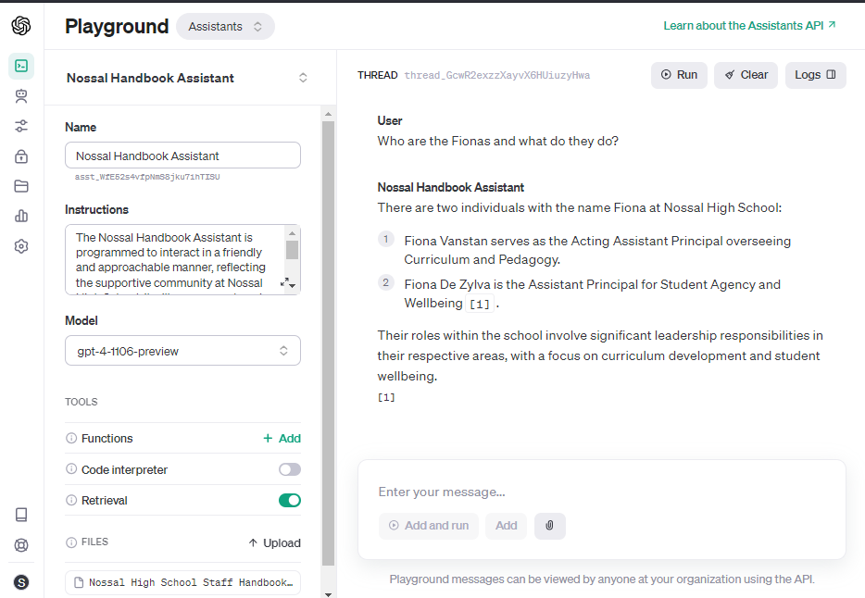

Slide 27
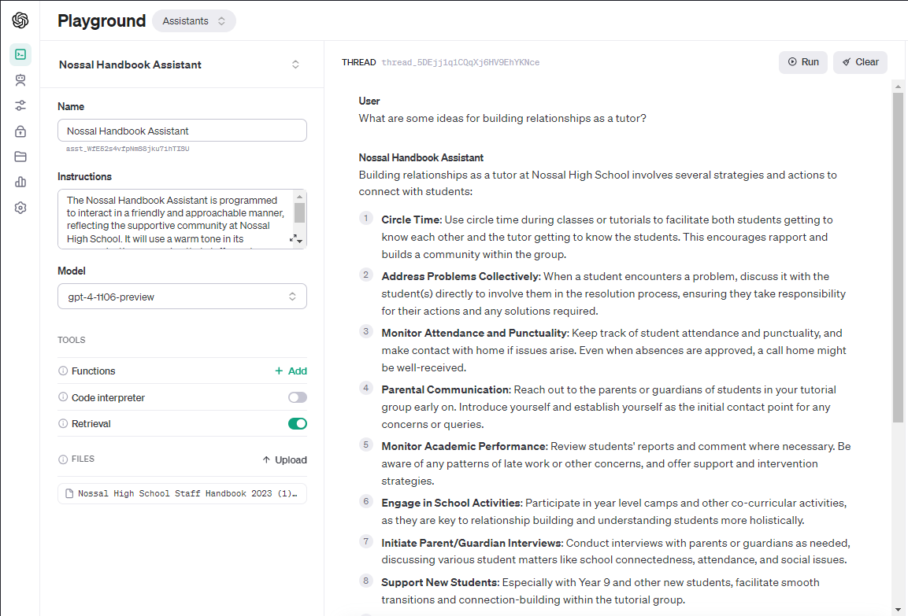

Slide 28
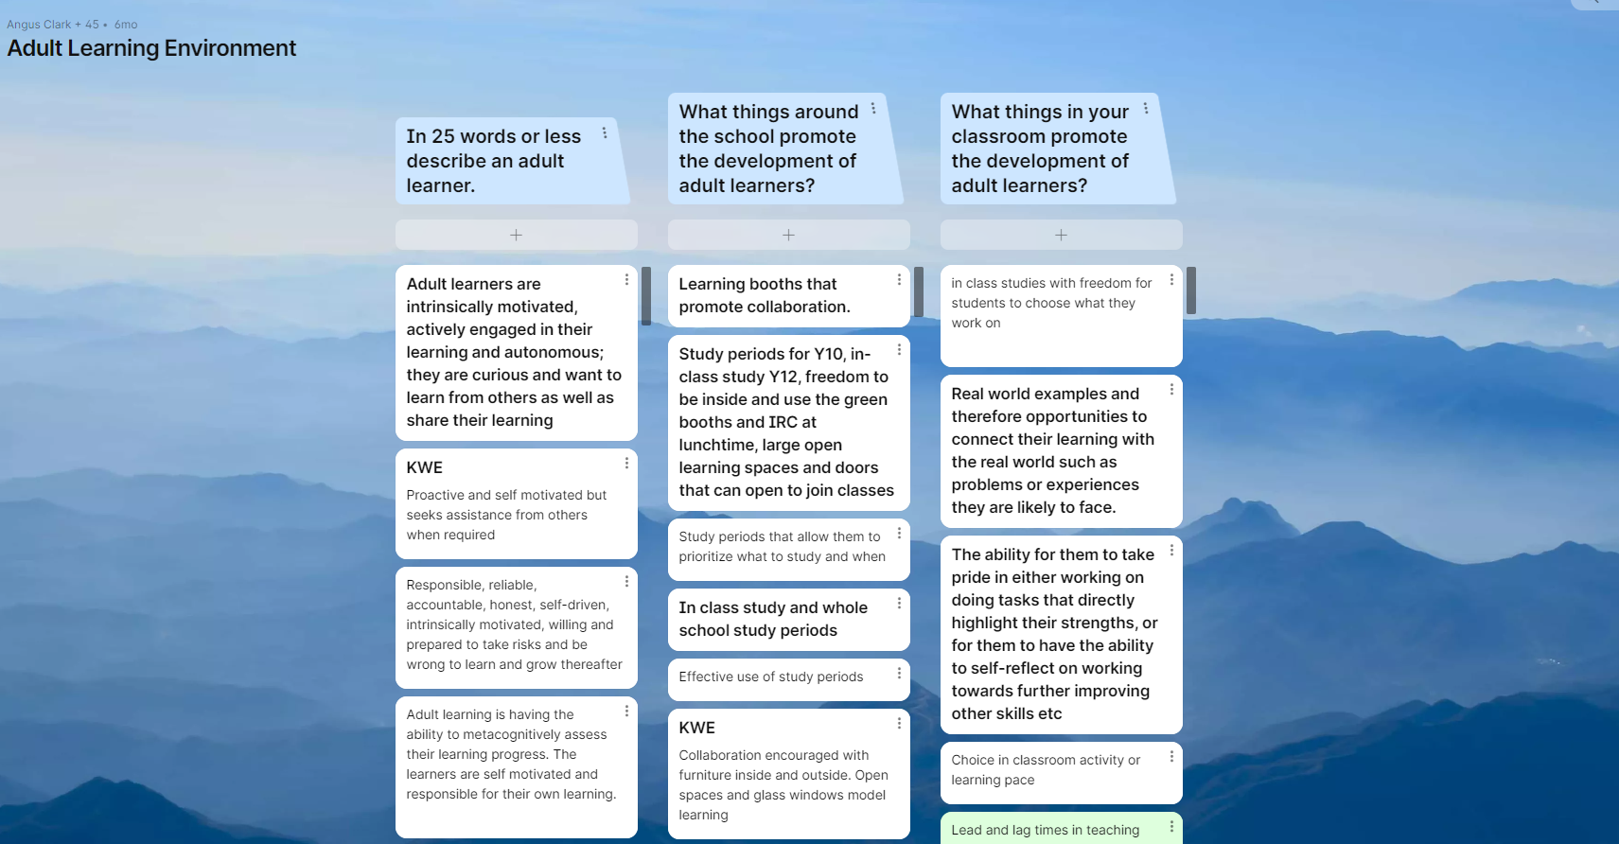
Effective use cases

Slide 29
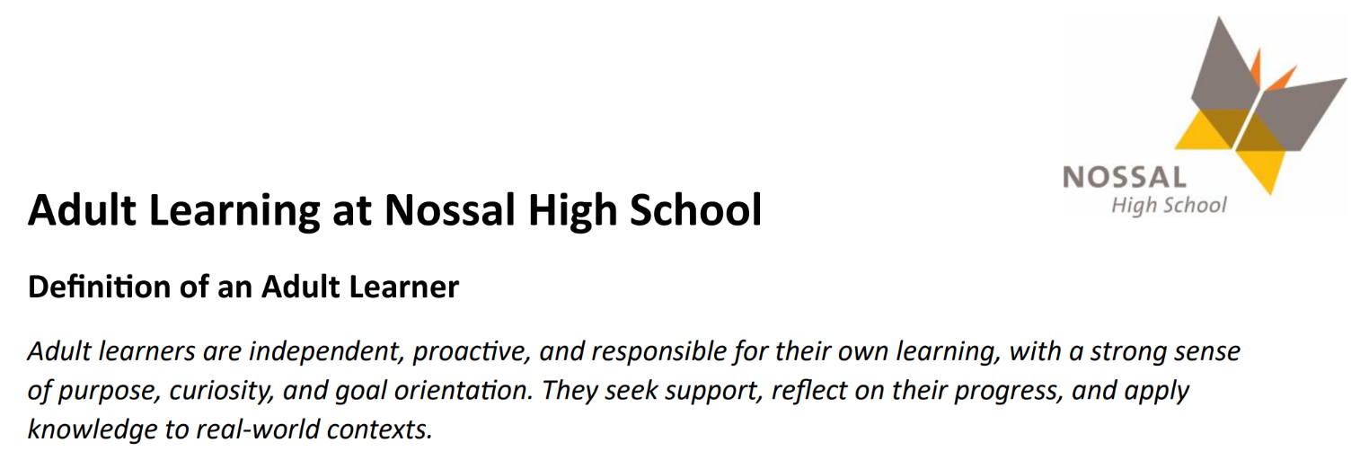
Staff Applications

Slide 30
THANK YOU
Tracey Mackin
Tracey.Mackin@nossalhs.vic.edu.au
Stuart Fankhauser
Stuart.Fankhauser@nossalhs.vic.edu.au
2023
Responding to AI at Nossal High School

