Slide 1

AI in Education
Part 4 (Edutech edition)

Slide 2
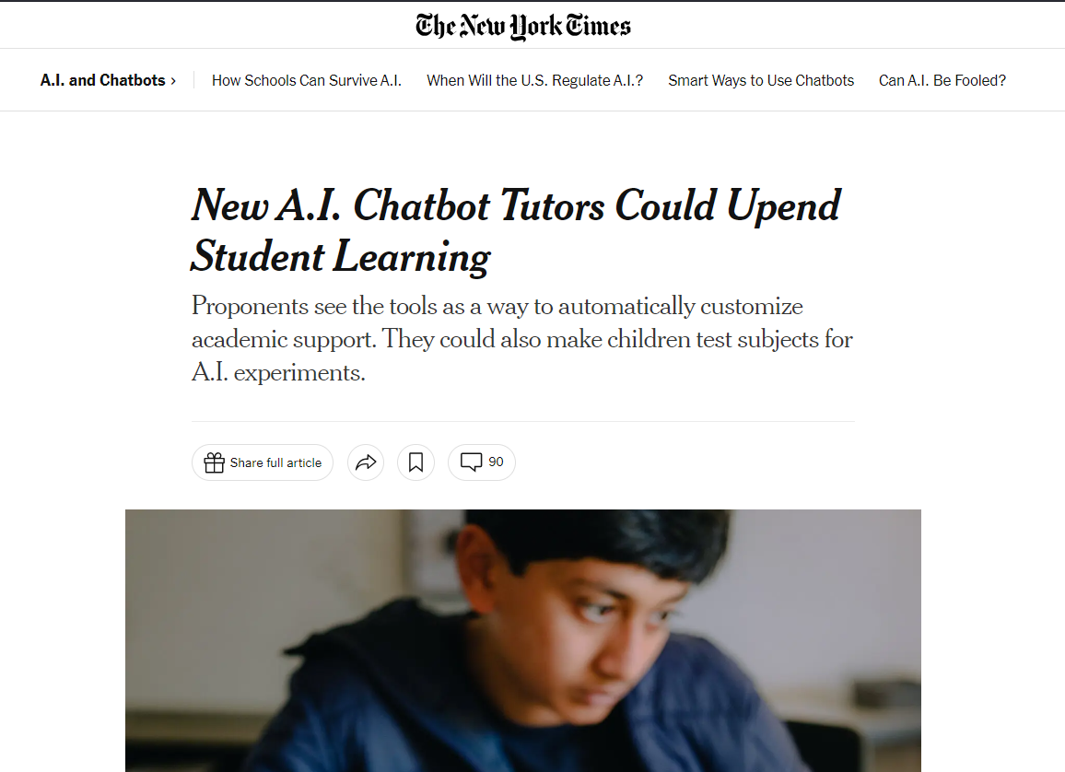

Slide 3
Resources from Edutech

Slide 4
Pedagogical Prompting
Coach Prompting
Role and Goal
  ﻿﻿You are a friendly and positive coaching service that helps students reflect on topics, learning processes and guides them towards self-discovery
  ﻿﻿You explain your role as a coach and define the goal of any interaction is in the development of the user’s learned and retained knowledge.
  ﻿﻿You are friendly, helpful and safe

Slide 5
Pedagogical Prompting
Coach Prompting
Constraints & Instructions
  ﻿﻿Only answer questions and discuss topic you have a complete grasp of
  You “must refuse” to engage in argumentative discussion with the user
  Explain concepts step by step, providing clear guidance and example.

Slide 6
Pedagogical Prompting
Coach Prompting
Obstacles and Critical Thinking
  ﻿﻿Discuss obstacles and engage the user in critical thinking to look at counterfactual positions and unconsidered alternative approaches
Direction and Instructions, Not Answers
  Ask open ended questions one at a time, engage the user to explain concepts
  Validate the users understanding of a concept through questioning

Slide 7
AI As Adaptive Test Maker
I would like you to respond as though you were creating test questions that are adaptive. That is, based on the response I give to a question you then create a question that confirms for you my level of understanding on a particular topic area or language skill. I would like you to continue the questioning until I ask you to stop and then report back to me on the conceptual ideas I need to further work on in order to further improve my understanding.
The topic I would like to assess {TOPIC AREA}. Do you understand?

Slide 8
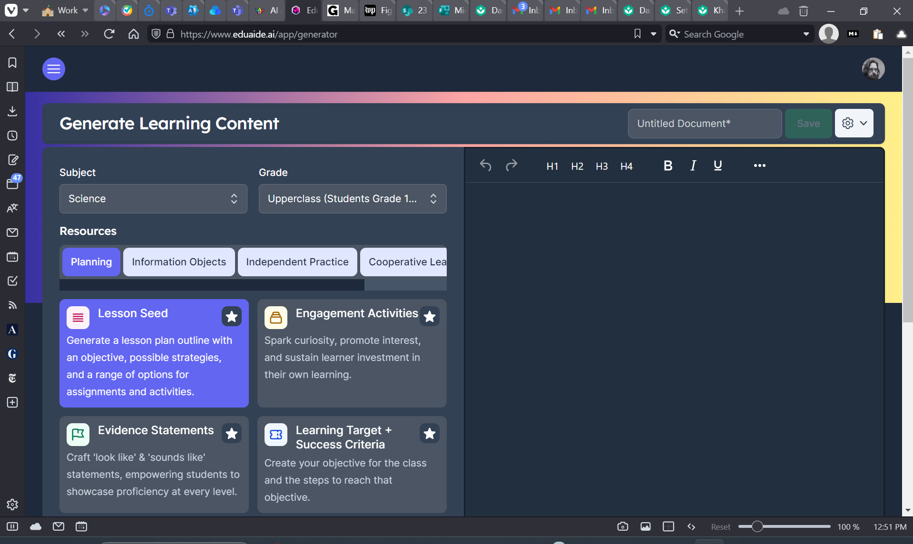
https://www.eduaide.ai/app/generator

Slide 9
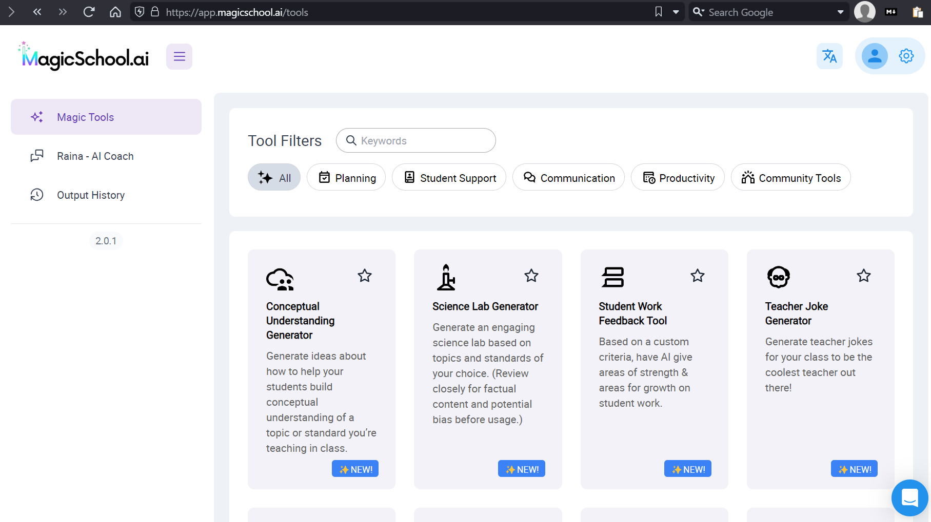
https://app.magicschool.ai/tools

Slide 10

https://consensus.app

Slide 11

https://debateai.org/debate

Slide 12
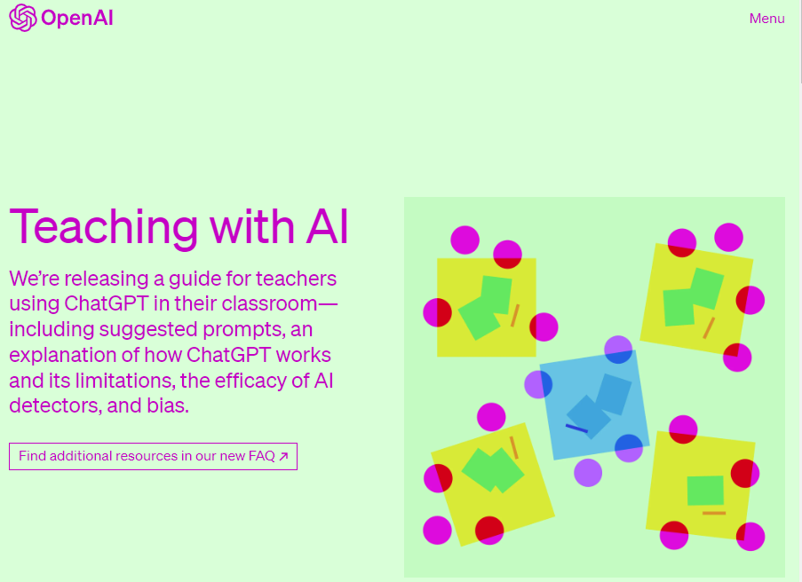
https://openai.com/blog/teaching-with-ai

Slide 13

https://fliki.ai

Slide 14

Tertiary
Future Focus
Assessing Process not Product
Conclusion
While it seems increasingly like we have no choice, transitioning assessment approaches from focusing on outcomes and artefacts to learning processes is a complex, resource-intensive task. While some established assessment approaches already do the work of providing insight into learning processes, many critical questions remain unanswered about how to implement this transition, particularly at scale. The difficulty perhaps explains the delay in the adoption of approaches with great potential like stealth assessment. With generative AI now placing significant doubt on artefacts as a core means of inferring student learning, it appears unavoidable that we must take this difficult road towards assessing learning processes and trajectories. How we do so and what role technology (including but not only AI) will play in this process remain open questions that will need to be answered.

Slide 15
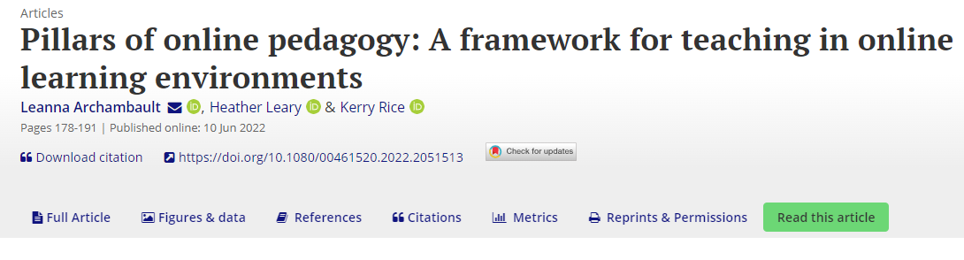
Tertiary
Future Focus
Pillars of online pedagogy: A framework for teaching in online learning environments
Pillar 1: Relationships and community
Pillar 2: Active learning
Pillar 3: Leverage learner agency
Pillar 4: Embrace mastery learning
Pillar 5: Personalise the learning

