Slide 1

AI in Education
Part 3

Slide 2
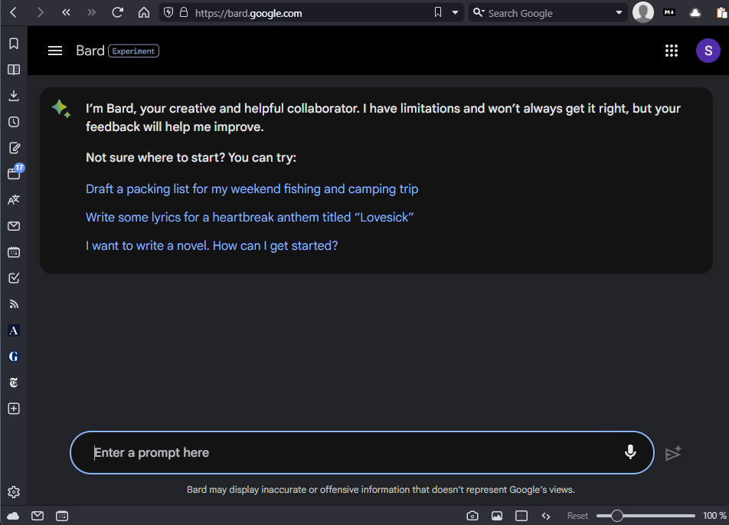
Hello Google Bard

Slide 3
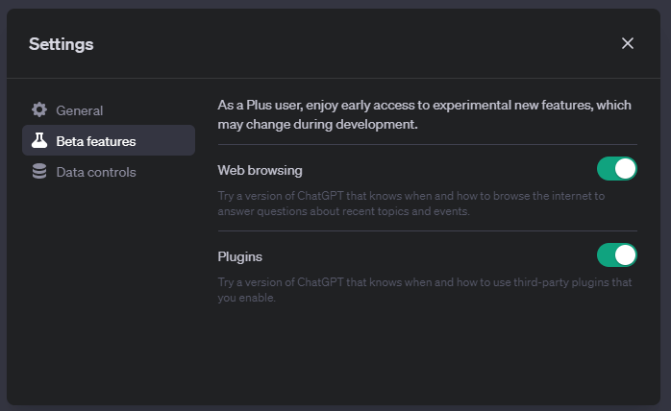
Hello ChatGPT 4
Significant accuracy upgrade from ChatGPT 3.5 (the free version)
It is a paid for service (~$30 a month – haves and have nots)
Upgraded mathematics capabilities
Outsources to other AIs and
plug-ins when it needs to
Is “up to date” with the world
The output is by default far less prosaic

Slide 4
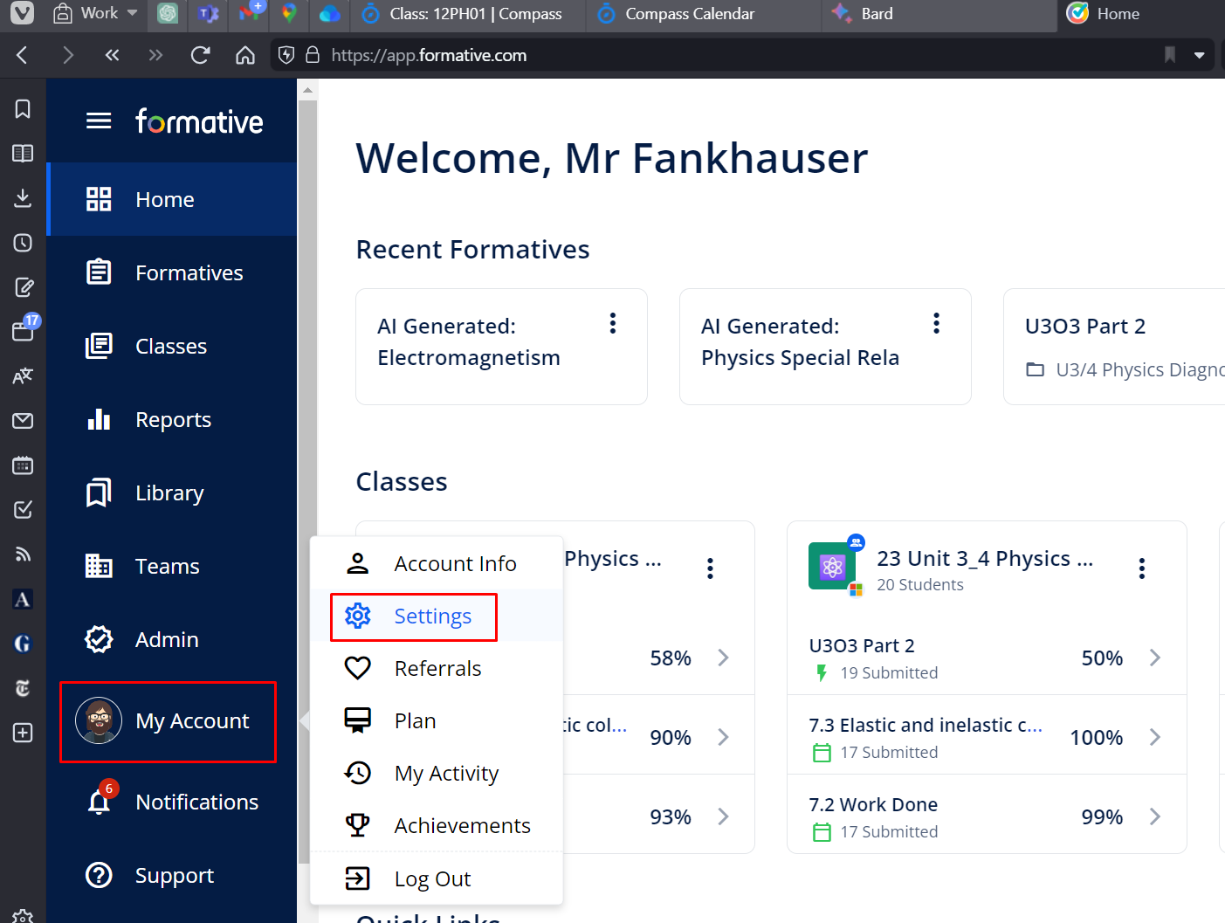
Hello Formative Generative AI

Slide 5
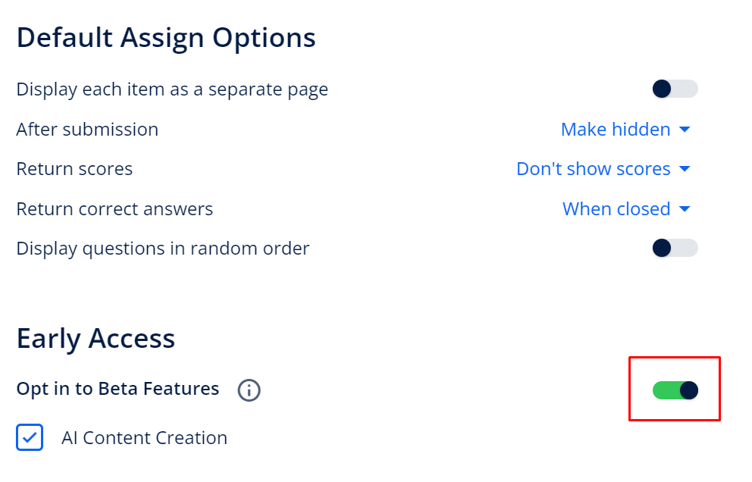
Hello Formative Generative AI

Slide 6
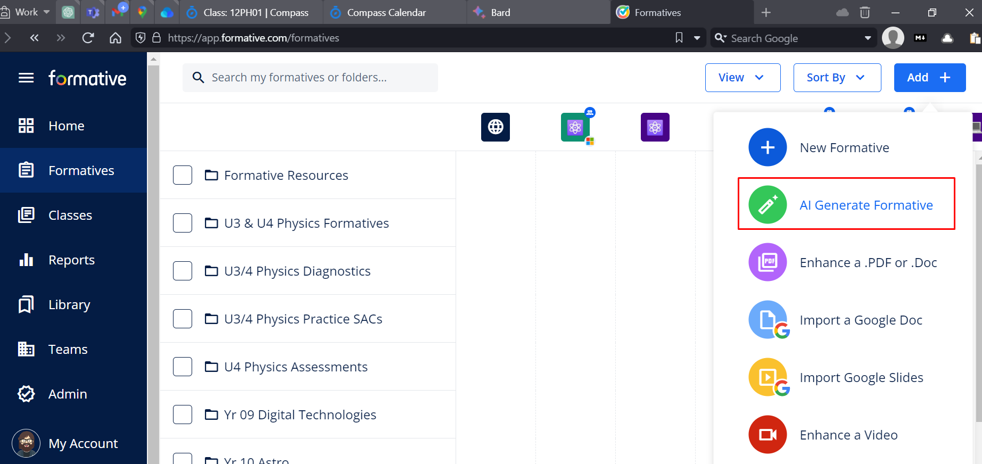
Hello Formative Generative AI

Slide 7
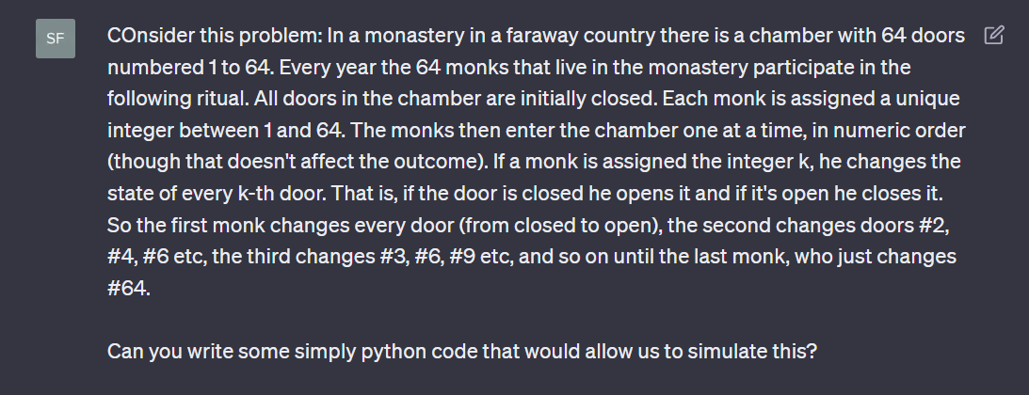

Slide 8
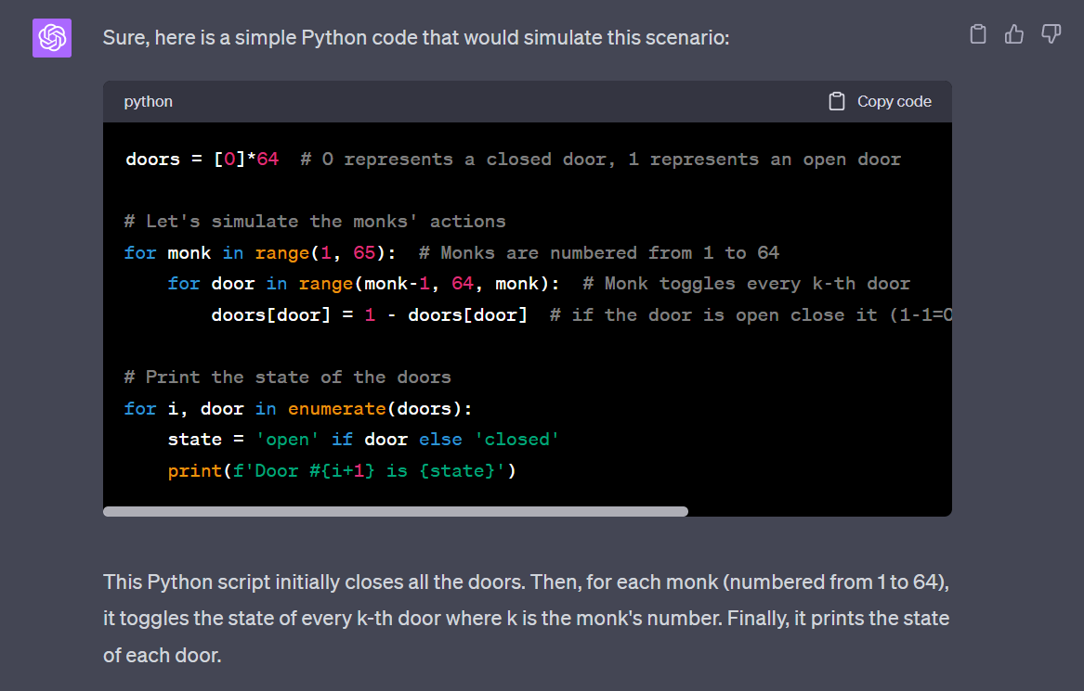

Slide 9


Slide 10
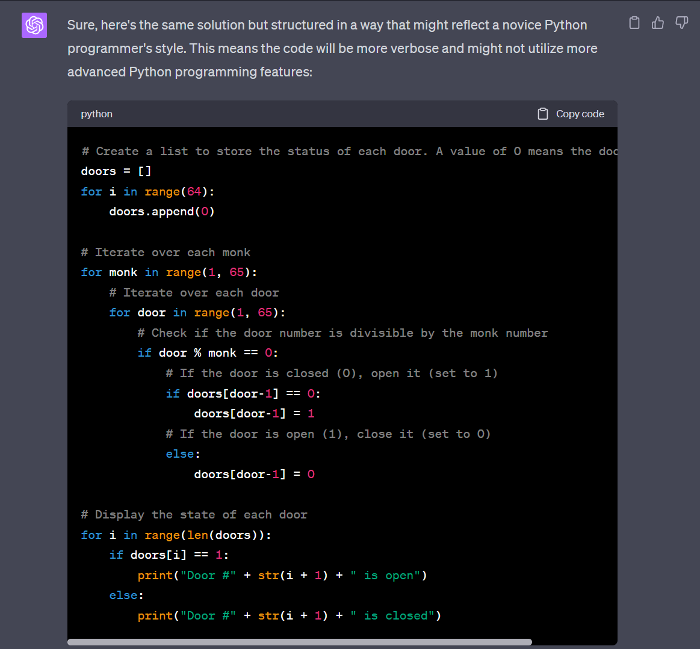

Slide 11
Recap!
AI is coming at us very quickly – much faster than traditional curriculum sources can adapt
Our students are using AI to assist them with their work already
Our students need counsel and direction regarding the ethical and social implications of utilizing AI, both in their education and in their future careers and personal lives.
It may possibly become one of the most significant elements of the digital divide

Slide 12
What AI student use already is…
Writing Assistance: AI-powered writing assistants can help students generate ideas and improve the quality of their writing. Students can use such tools to refine their writing skills and produce more polished work.
Research Assistance: AI-powered search engines can help students find relevant and credible sources for their research. Students can use these tools to save time and improve the quality of their work.
Writing Feedback: AI-powered writing assistants can provide feedback on writing assignments, making suggestions for improvements and help students to produce more polished and refined work.

Slide 13
What AI student use already is…
Test Preparation: AI-powered test preparation tools can help students prepare for exams by identifying areas where they need to focus their study efforts and providing practice questions and exercises.
Completing Data Analysis: AI-powered data analysis tools can help students analyze complex data sets and identify patterns and trends. This can help students develop their analytical skills.
Automated Summarization: AI-powered summarization tools can help students quickly and accurately summarize long texts and articles. This can help students better understand complex ideas and identify key themes and arguments.

Slide 14
Student Based Responses to AI
What might students consider when it comes to the availability of AI LLMs and their learning? There are 2 dignificant things we need to think about…
Am I undertaking this task to jump a hurdle around learning that I am not invested in, or feel too time poor to adequately address?
Am I undertaking this task because the related learning is essential to me right and avoiding it will have consequences that concern me?

Slide 15
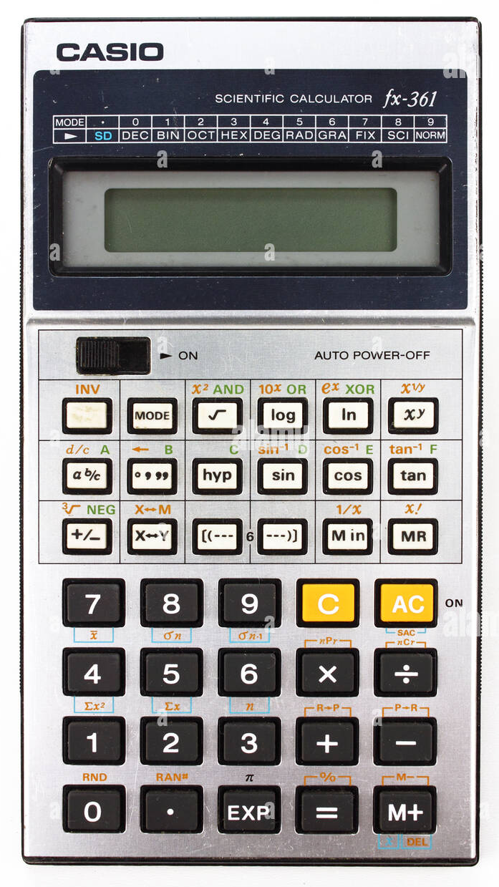
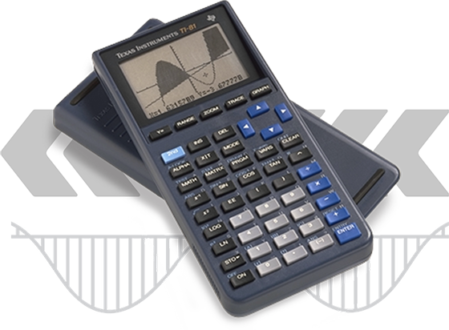
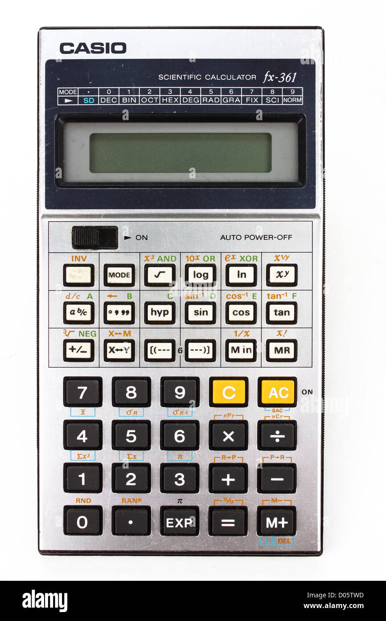
AI & Learning
Late 1970 to mid 1980s Mid 90s onwards

Slide 16
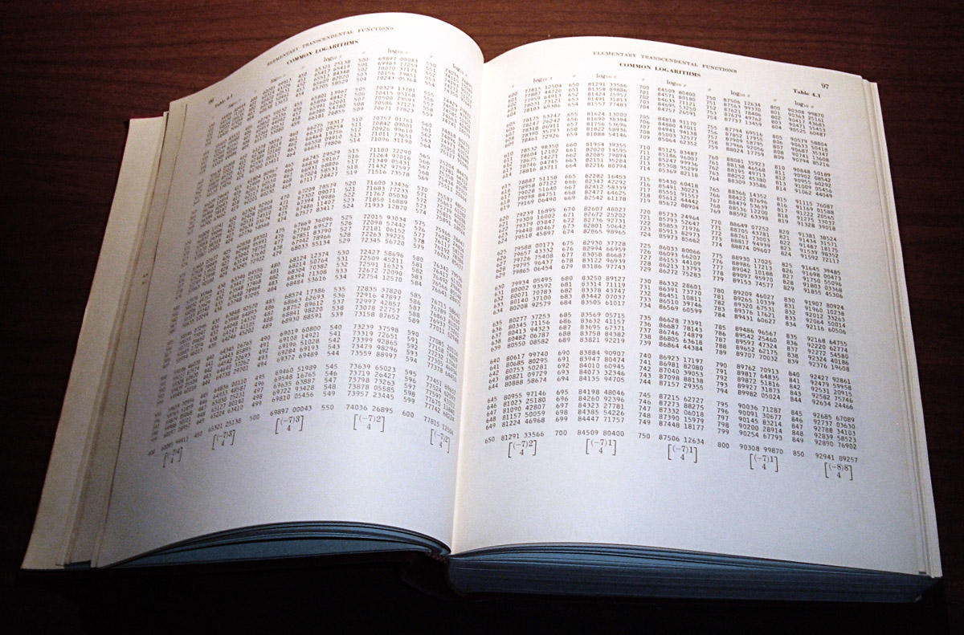
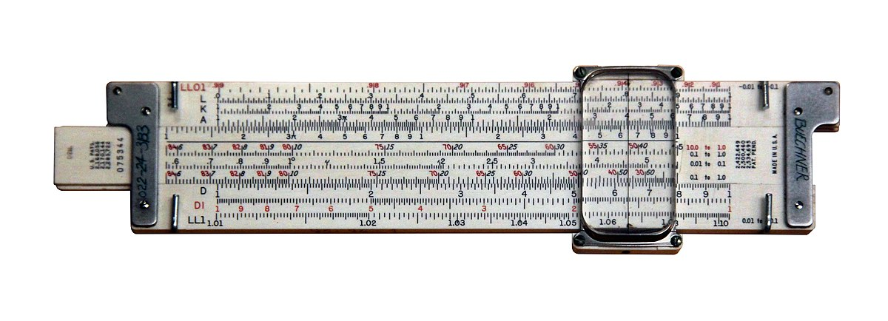
AI & Learning
Mathematics Education underwent a transformation
The pressure point driving the change was reasonably slow moving
Time was spent carefully considering which skills remained essential and needed to be learned
Over the course of YEARS, calculators went from hot debate to essential tool

Slide 17
AI & Learning
The change for Maths was driven by cost and accessibility
(a democratization of the technology)
But…
  Generative AI is already ‘democratized’
  Generative AI effects all faculties/domains
  Generative AI requires a conversation about where it sits in the classroom

Slide 18
AI in Learning
How long will it take ACARA to update the Australian curriculum?
How will ACARA update the Australian curriculum?
It’s up to us to do what Mathematics teachers across the world did over the course of a decade and identify the key learning our students need for our subject areas.
We need to make it obvious and easy for students to know when it is OK and when it is not a good idea to use AI.
Telling them never to use it is pointless.

Slide 19
AI in Learning - Suggested Response
Like Learning Intentions for each lesson, the use of AI in students’ learning should be explicitly stated for each content area.
Red | Strongly recommended that the use of AI is avoided when learning this content, skill or information. Refer to teacher instruction and resources only. (eg. students should learn basic arithmetic and number skills before being introduced to a calculator. ) | You are likely to hurt your learning and set back your understanding.
Amber | AI should be used with caution. If AI is used to complement the development of your understanding, the information you are accessing should be verifiably accurate and appropriate. (eg. asking an AI for a full solution when a verifiable answer is given) | Without active supervision from an expert, your understanding may be impacted negatively.
Green | AI can be used to assist with the development of your understanding of this skill or content area. Suggested learning prompts have been provided as examples from your teacher. (eg. Asking an AI for drafting feedback or the summarization of a piece of text) | Your learning can be enhanced by working with an AI in this space. Always remember to think critically and be skeptical of responses during AI interactions.

Slide 20
Year 10 Astronomy AI Statement
Red (Avoid AI) | The solving of questions from the worksheets that require the use of mathematics Writing the text of your research task.
Amber (Use AI with Caution) | Revisiting challenging questions in class where the working is not available but a solution can be checked or verified with your teacher. Researching factual information relating to the key questions of your research task. All AI responses need to be verified to ensure they are factually correct.
Green (Use AI to assist your learning with | For your research task you may use AI to assist with drafting or your written work and for idea generation around areas that can be explored. Some suggested prompts would be: With regard to the text below, can you provide feedback to assist me in ensuring it is written in the third person, that it is in a scientific voice and important factual information is identified with in-text referencing. What were the key milestones in developing the theory behind the formation of Pulsars? For further developing your understanding of key concepts covered in the course. Some example prompts might be: What were the key ideas of Copernicus that Galileo used in developing his arguments for heliocentrism? What is behind the relationship between the rate of black hole evaporation and Hawking radiation?

